Slide 1
Lecture 01 – Part A
Advanced Artificial Intelligence
Dr. Shazzad Hosain
Department of EECS
North South University
shazzad@northsouth.edu

Slide 2
Syllabus
Course Description
  This course provides a general introduction to AI (Artificial Intelligence): Its techniques and its main sub-fields.
  It gives an overview of underlying ideas, such as search, knowledge representation, expert systems and learning.

Slide 3
Syllabus
Recommended Books:
  “Artificial Intelligence: A modern approach” Stuart Russell, Peter Norvig, Prentice Hall, 2003 (new edition 2006)
  “Artificial Intelligence Illuminated” Ben Coppin, Jones and Bartlett illuminated Series, 2004
  “Artificial Intelligence: A new synthesis” Nils Nilsson, Morgan Kaufmann, 1998
  “Artificial Intelligence – Structures and Strategies for Complex problem solving", George F. Luger, Pearson International Edition, Sixth edition, 2009.

Slide 4
Syllabus
Item | Marks
Attendance | 5%
Quizzes (best 3 out of 4) | 20%
Assignments / Project | 20%
Mid Term (No Make up) | 25%
Final | 30%
Total | 100%
http://w3.northsouth.edu/php/faculty/shazzad/teaching.html

Slide 5
Syllabus
Course Overview (main topics)
  What is AI?
  problem solving by search
  logic, knowledge representation & reasoning
  expert systems: an introduction
  learning: decision trees, artificial neural networks
  Game playing

Slide 6
What is Artificial Intelligence?

Slide 7
What is Intelligence ?
Intelligence may be defined as:
  The capacity to acquire and apply knowledge.
  The faculty of thought and reason.

Slide 8
What is Artificial Intelligence ?
Artificial intelligence is the study of systems that act in a way that to any observer would appear to be intelligent.
Artificial Intelligence involves using methods based on the intelligent behavior of humans and other animals to solve complex problems.
AI is concerned with real-world problems (difficult tasks), which require complex and sophisticated reasoning processes and knowledge.

Slide 9
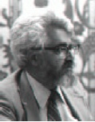
What is Artificial Intelligence ?
“AI is the study of ideas that enable computers to be intelligent.”
[P. Winston]
“It is the science and engineering of making intelligent machines, especially intelligent computer programs. It is related to the similar tasks of using computers to understand human intelligence, but AI does not have to confine itself to methods that are biologically observable.”
John McCarthy, Stanford University, computer Science Department.
John McCarthy

Slide 10
What is Artificial Intelligence?
Some Definitions
  Weak AI: AI develops useful, powerful applications.
  Strong AI: claims machines have cognitive minds comparable to humans.
In this course, we deal with Weak AI.

Slide 11
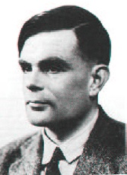
What is Artificial Intelligence?
Operational Definition of AI
(Turing Test):
In 1950 Turing proposed an operational definition of intelligence by using a Test composed of :
  An interrogator (a person who will ask questions)
  a computer (intelligent machine !!)
  A person who will answer to questions
  A curtain (separator)
A. Turing

Slide 12
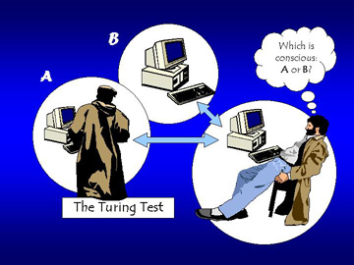
What is Artificial Intelligence?
The computer passes the “test of intelligence” if a human, after posing some written questions, cannot tell whether the responses were from a person or not.

Slide 13
What is Artificial Intelligence
To give an answer, the computer would need to possess some capabilities:
  Natural language processing: To communicate successfully.
  Knowledge representation: To store what it knows or hears.
  Automated reasoning: to answer questions and draw conclusions using stored information.
  Machine learning: To adapt to new circumstances and to detect and extrapolate patterns.
  Computer vision: To perceive objects.
  Robotics to manipulate objects and move.

Slide 14
What is Artificial Intelligence ?
Goals of AI:
AI began as an attempt to understand the nature of
intelligence, but it has grown into a scientific and
technological field affecting many aspects of commerce
and society. The main goals of AI are:
  Engineering: solve real-world problems using knowledge and reasoning. AI can help us solve difficult, real-world problems, creating new opportunities in business, engineering, and many other application areas

Slide 15
What is Artificial Intelligence ?
Goals of AI (cont’d)
  Scientific: use computers as a platform for studying intelligence itself. Scientists design theories hypothesizing aspects of intelligence then they can implement these theories on a computer.
Even as AI Technology becomes integrated into the fabric
of everyday life. AI researchers remain focused on the grand
challenges of automating intelligence.

Slide 16
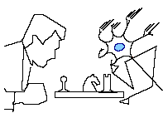
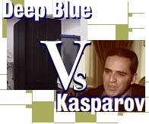
What is Artificial Intelligence ?
Examples of AI Application systems:
Game Playing
  TDGammon, the world champion backgammon player, built by Gerry Tesauro of IBM research
  Deep Blue chess program beat world champion Gary Kasparov
  Chinook checkers program

Slide 17
What is Artificial Intelligence ?
Examples of AI Application systems:
Natural Language Understanding
  AI Translators – spoken to and prints what one wants in foreign languages.
  Natural language understanding (spell checkers, grammar checkers)

Slide 18
What is Artificial Intelligence ?
Examples of AI Application Systems:
Expert Systems:
In geology
  prospector expert system carries evaluation of mineral potential of geological site or region
Diagnostic Systems
  Pathfinder, a medical diagnosis system (suggests tests and makes diagnosis) developed by Heckerman and other Microsoft research
  MYCIN system for diagnosing bacterial infections of the blood and suggesting treatments

Slide 19
What is Artificial Intelligence ?
Examples of AI Application Systems:
Expert Systems:
Financial Decision Making
  Credit card providers, banks, mortgage companies use AI systems to detect fraud and expedite financial transactions.
Configuring Hardware and Software
  AI systems configure custom computer, communications, and manufacturing systems, guaranteeing the purchaser maximum efficiency and minimum setup time.

Slide 20
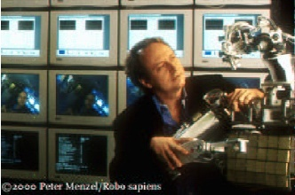
What is Artificial Intelligence ?
Examples of AI Application Systems:
Robotics:
  Robotics becoming increasing important in various areas like: games, to handle hazardous conditions and to do tedious jobs among other things. For examples:
- automated cars, ping pong player
- mining, construction, agriculture
- garbage collection

Slide 21
What is Artificial Intelligence ?
Examples of AI Application systems:
Other examples:
Handwriting recognition (US postal service zip code readers)
Automated theorem proving
  use inference methods to prove new theorems
Web search Engines

Slide 22
AI Topics:
A Quick Introductory Overview
The main AI topics we’ll cover in this course:
Problem solving by searching
(Uninformed search, heuristic search …)
Knowledge-based systems
(expert systems …)
Machine learning
(neural networks, RL …)
Artificial Life <Modern AI>
(cellular automata, GAs …)

Slide 23
AI Topics:
A Quick Introductory Overview
Problem Solving by Searching
Why search ?
Early works of AI was mainly towards
  proving theorems
  solving puzzles
  playing games
All AI is search!
  Not totally true (obviously) but more true than you might think.
  Finding a good/best solution to a problem amongst many possible solutions.

Slide 24
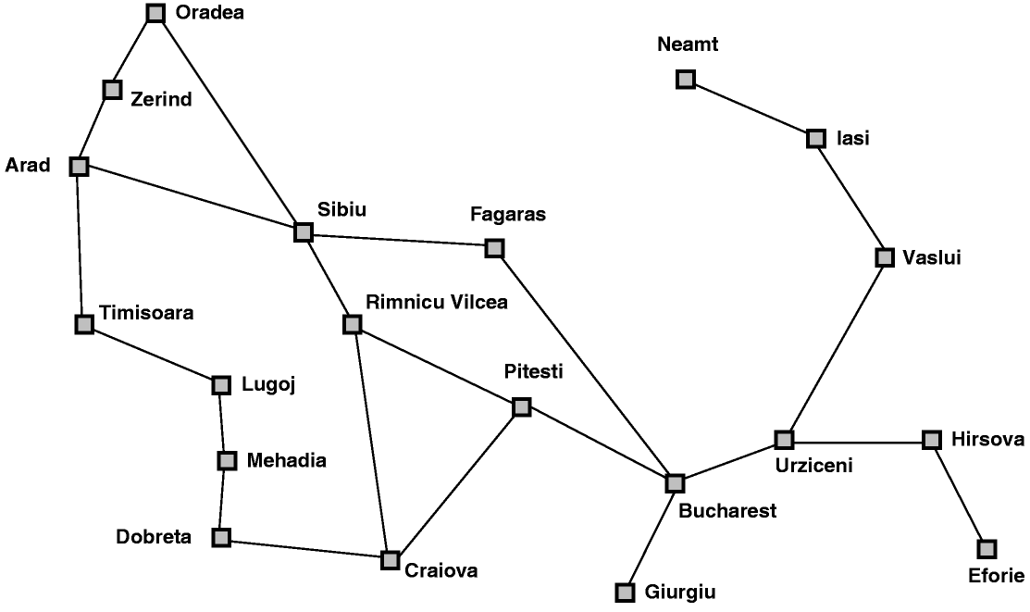
AI Topics:
A Quick Introductory Overview
Classic AI search problems
Map searching (navigation)

Slide 25
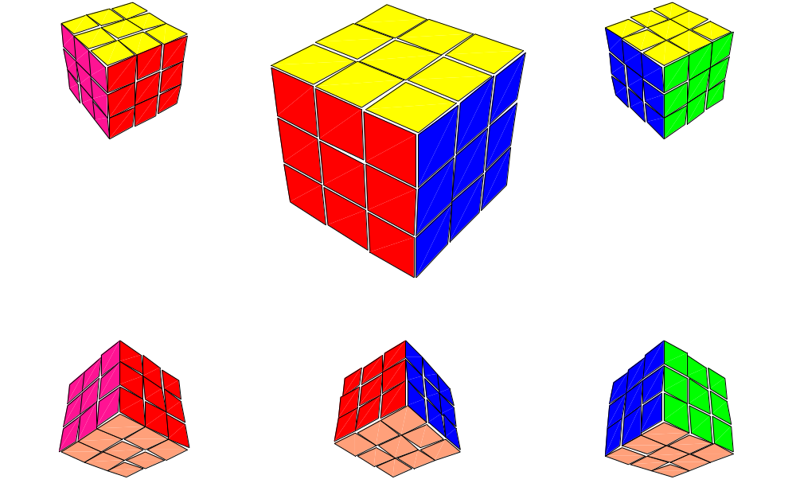
AI Topics:
A Quick Introductory Overview
Classic AI search problems
3*3*3 Rubik’s Cube

Slide 26
AI Topics:
A Quick Introductory Overview
Classic AI search problems
8-Puzzle
2
1
3
1
2
3
4
7
6
4
5
6
5
8
7
8

Slide 27
AI Topics:
A Quick Introductory Overview
Knowledge-based system
expert system (or knowledge-based system): a program which encapsulates knowledge from some domain, normally obtained from a human expert in that domain
components:
  Knowledge base (KB): repository of rules, facts (productions)
  working memory: (if forward chaining used)
  inference engine: the deduction system used to infer results from user input and KB
  user interface: interfaces with user
  external control + monitoring: access external databases, control,...

Slide 28
AI Topics: A Quick Introductory Overview
Knowledge-based system
Why use expert systems:
  commercial viability: whereas there may be only a few experts whose time is expensive and rare, you can have many expert systems
  expert systems can be used anywhere, anytime
  expert systems can explain their line of reasoning
  commercially beneficial: the first commercial product of AI
Weaknesses:
  expert systems are as sound as their KB; errors in rules mean errors in diagnoses
  automatic error correction, learning is difficult (although machine learning research may change this)
  the extraction of knowledge from an expert, and encoding it into machine-inferrable form is the most difficult part of expert system implementation

Slide 29
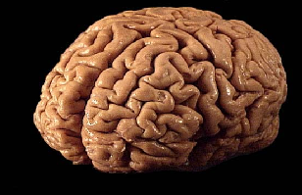
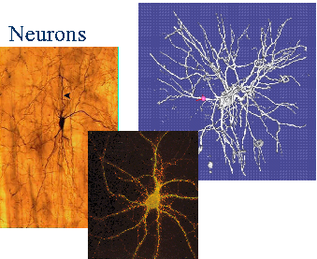
AI Topics:
A Quick Introductory Overview
Machine Learning : Neural Nets
  Neural nets can be used to answer the following:
  Pattern recognition: Does that image contain a face?
  Classification problems: Is this cell defective?
  Prediction: Given these symptoms, the patient has disease X
  Forecasting: predicting behavior of stock market
  Handwriting: is character recognized?
  Optimization: Find the shortest path for the TSP.

Slide 30
AI Topics:
A Quick Introductory Overview
Machine Learning : Neural Nets
Artificial Neural Networks: a bottom-up attempt to model the functionality of the brain.
Two main areas of activity:
  Biological: Try to model biological neural systems.
  Computational:
    Artificial neural networks are biologically inspired but not necessarily biologically plausible.
    So may use other terms: Connectionism, Parallel Distributed Processing, Adaptive Systems Theory.
Interests in neural networks differ according to profession.

Slide 31
AI Topics:
A Quick Introductory Overview
Nouvelle AI : Artificial Life & Complex Systems
Artificial Life: An attempt to better understand “real” life by in-silico modeling of the entities we are aware of.
Motivations:
  A-Life could have been dubbed as yet-another-approach to studying intelligent life, had it not been for the Emergent properties in life that motivates scientists to explore the possibility of artificially creating life and expecting the unexpected.
  An Emergent property is created when something becomes more than sum of its parts.

Slide 32

AI Topics:
A Quick Introductory Overview
Artificial Life : Cellular Automata
Conway’s Life: Rules
A living cell with 0-1 8-neighbors dies of isolation
A living cell with 4+ 8-neighbors dies from overcrowding
All other cells are unaffected
Cellular Automata (CA) is an array of N-dimensional ‘cells’ that interact with their neighboring cells according to a pre-determined set of rules, to generate actions, which in turn may trigger a new series of reactions on itself or its neighbors.
The best known example is Conway’s Life, which is a 2-state 2-D CA with simple rules (see on right) applied to all cells simultaneously to create generations of cells from an initial pattern.

Slide 33


AI Topics:
A Quick Introductory Overview
Cellular Automata: The Game of Life
Simple transition rules give rise to complex patterns (Emergent Structures)…

Slide 34
What is Artificial Intelligence ?
To conclude:
  AI is a very fascinating field. It can help us solve difficult, real-world problems, creating new opportunities in business, engineering, and many other application areas.
  Even though AI technology is integrated into the fabric of everyday life. The ultimate promises of AI are still decades away and the necessary advances in knowledge and technology will require a sustained fundamental research effort.

